Slide 1

AIRBNB Analysis
An overview of 5555 listings

Slide 2
‘Man can’t discover unless he has the courage to lose sight of the shore’
- Andre gide

Slide 3
WWW- World Wide Wander
Beginning with the world we see, we need the countries where we have a room to occupy and where we need some peace of mind to enjoy the moment.
There comes the map we see where we can find the location that we like to occupy according to our needs, we see that there are few countries where we can find the basic requirements of the occupancy according to the category of the room available,
It can either be for 365 days,
Or for 90, 60 and 30 days and less.
This map gives that particular information…

Slide 4
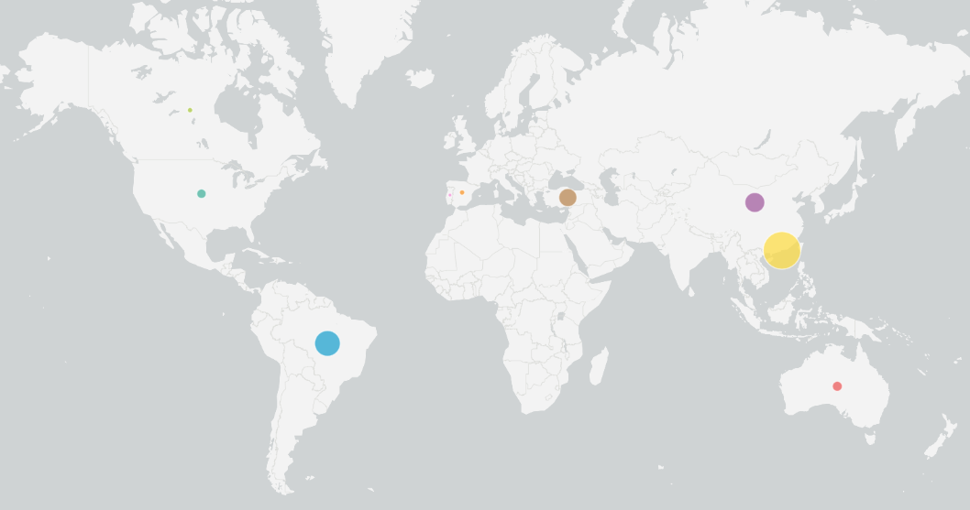

Slide 5
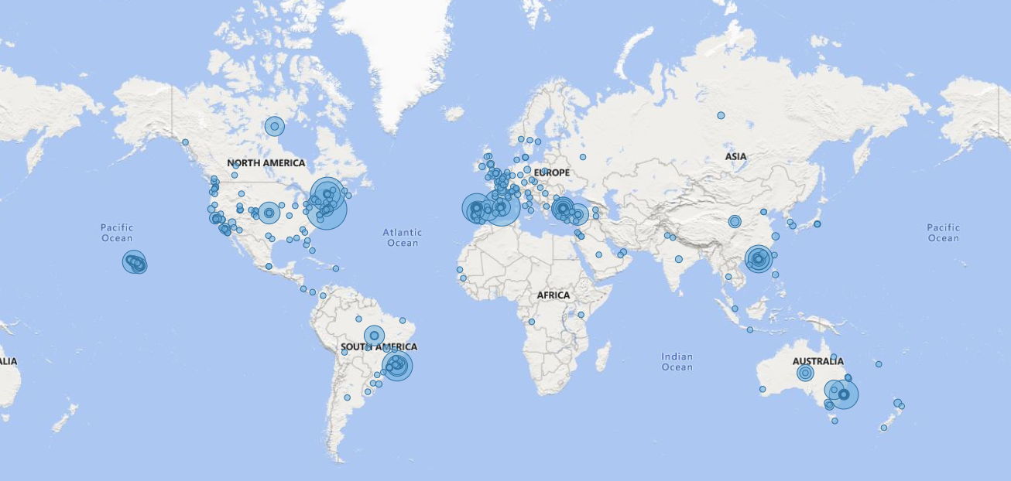

Slide 6
Move to peace
Once we get the basic information of where there is availability we can straight forward move there, but wait where we go without knowing the location, for that we see this map and delve straight forward to that exact location with out any doubt.
This map give the exact location including the street so that we can simply drive to that location without any inconvenience. This map also gives the response time of your host including the location type of the property and the kind of the room we like to occupy, Inc ;
1. Location of the host.
2. Time to response.
3. Kind of property and room

Slide 7
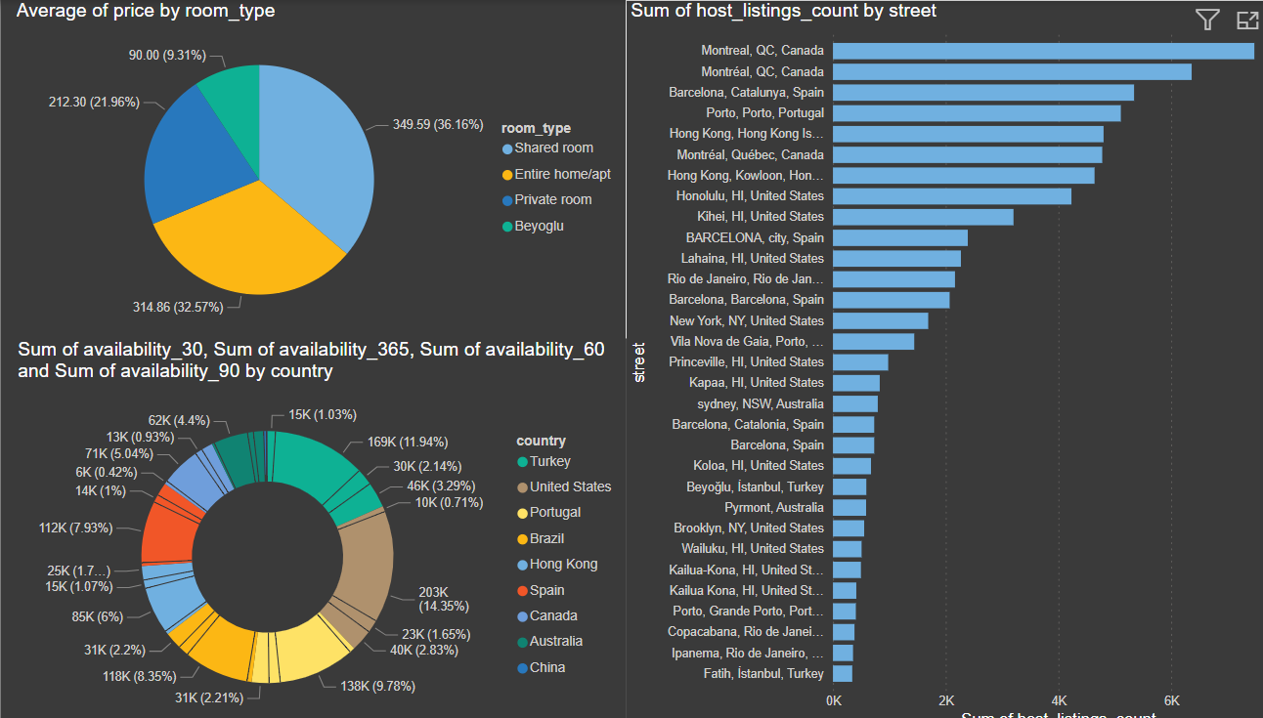
Pricing Details
Before all what we see is the pricing details of different locations as each and everyone must be satisfied:
1. This chart gives the information about the average price by the room type where we can see that the average price is more for entire home or apartment which is reasonable for all aspects.
2. Besides that it also provides the information about the availability with number of days.
3. Most probably giving the exact street makes us little more advantageous to reach and what is the count helps to find them easily.

Slide 8
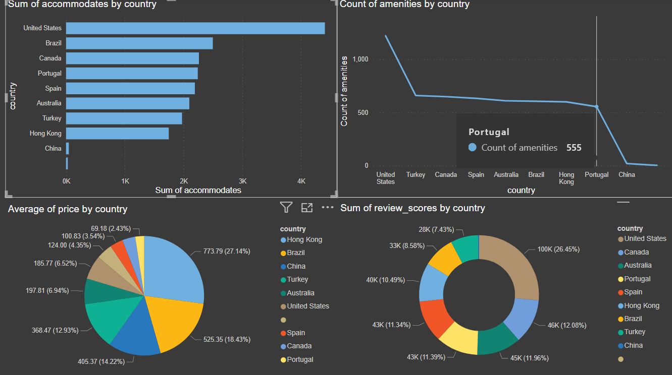
Accommodation and amenities
Even before the location and pricing one needs to know where the accommodation is present around the world and what are the amenities that are present in that particular country.
This chart gives that information regarding that where we can see that which country has more accommodation and amenities with their pricing and reviews, which are in fact very important.
So, gathering these in one chart helps us to understand where we can have the best holiday.
1. Best in class accommodations and amenities.
2. Pocket friendly places, with best reviews gives the best out come of the places.

Slide 9
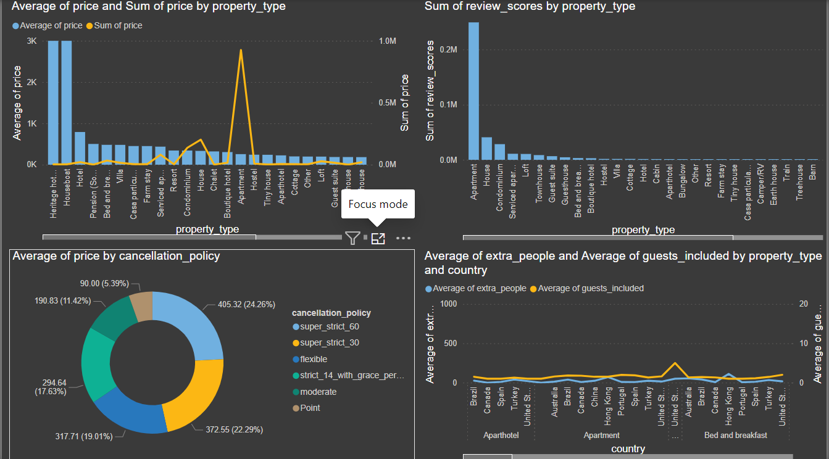
Cancellation Policies
1. Sometimes things go out of our control where nothing happens as we thought, this is where we need cancellation and refund which is the most best user friendly category where we have high feasibility. So, we need to check if that is true or not so here we have the cancellation policies and prices according to them.
2. Not only that an unexpected guest is common sometimes so that we even need to flexibility of the accommodation where there is an allowance to the guest more than one, here is the info regarding that where even we can see the prices according to the type of accommodation,

Slide 10
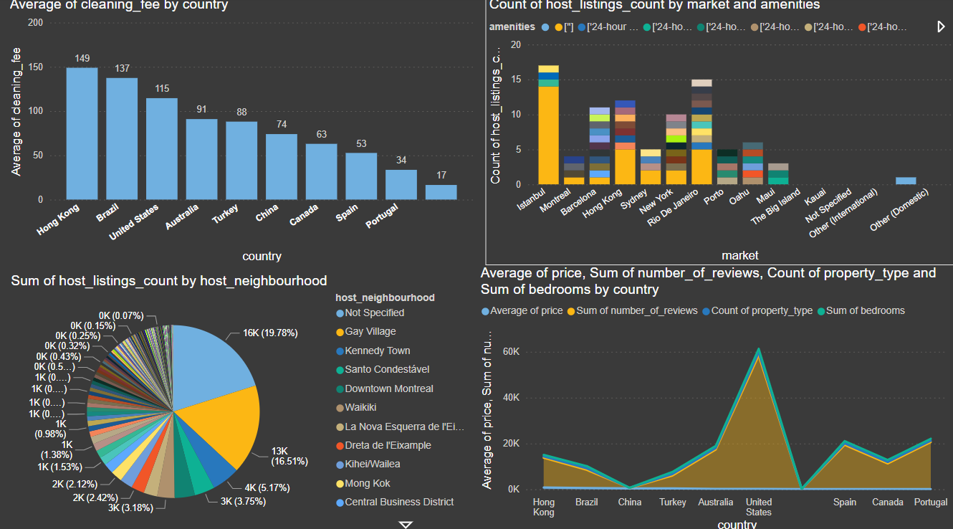
Neatness & Neighbourhood
Man is a social animal, meaning that man needs social interactions to thrive, making the choice of location and neighborhood crucial. This chart provides detailed information about: The neighborhood of each host. The types of neighborhoods available. Proximity to the nearest city or town for emergency concerns. Information on local markets and bed-room. Cleanliness levels and associated charges. Cleanliness is essential, as no one wants to live near a dump. Here, cleanliness refers to how well-maintained the rooms are and the pricing for such services. It's noted that paying $1000 for cleaning is often impractical when many options are available at lower costs. This detailed analysis ensures you can make an informed decision about where to stay, balancing neighborhood quality, cleanliness, and cost considerations.

Slide 11
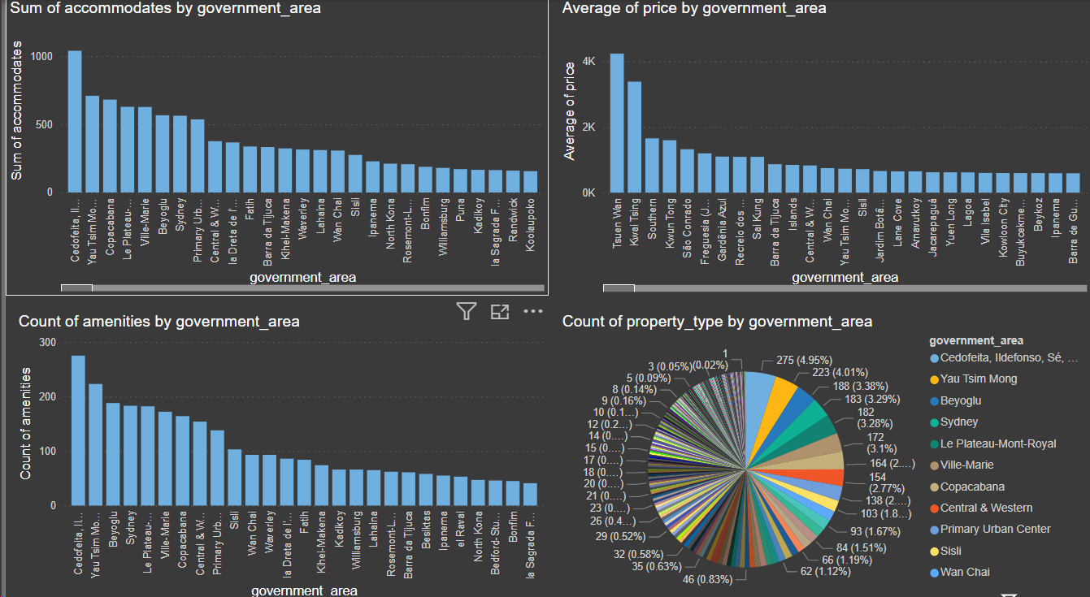
Government Residentials
Government employees and others often explore residential areas near official locations for accommodation.
A presentation provides detailed data on government properties and their market values, categorized by cities and countries.
This analysis offers valuable insights into the availability and pricing of such properties. Stakeholders can make informed decisions based on the delineated information, aligning residential choices with professional needs.
This strategic approach empowers individuals to navigate the real estate market effectively, balancing personal preferences with professional requirements.

Slide 12

--Learning is an art and mistakes can be ignored…
Thank you

